Slide 1
Legal system for Business

Slide 2
Module 1- SOURCES OF LAW
Classification of law
Indian contract Act 1872
Essential elements of contract
Types of contract
Breach of contract
Legality of objects and consideration
Law of indemnity, and Guarantee, Bailment and Pledge,Law of Agency

Slide 3
Introduction
Law affects every aspects of our life.
Not only governs our conduct. It influences on our lives- our birth and continues even after our death.
From a common person’s perspective, Law may be defined as a regulating mechanism enforced by the state to control and police human conduct in order to maintain peace and order in the society.
Basic aim of law is the attainment of justice in the society

Slide 4
Classification of law
Constitutional Law
International Law
Administrative Law
Criminal Law
Civil Law
Business Law.

Slide 5
BUSINESS LAW
Also known as Mercantile law or Commercial law.
Not a separate branch of law, it’s a part of civil law- regulates various kinds of business transactions.
It deals with the rights and obligations of persons arising out of commercial transaction.
Includes law relating to contracts, sale of goods act, partnership, negotiable instruments, insurance …

Slide 6
Sources of business law
English Mercantile law
Judicial decision or Law by Precedents
Indian statute law( acts enacted by Indian Legislature)
Customs and Trade Usage

Slide 7
Why legal aspects of business included?
Every aspects of business occurs within a legal environment.
Provides a practical and comprehensive framework of legal rules and principles to assist an organization.
Ensure a sufficient level of protection.

Slide 8
Indian Contract Act 1872
The Act was came into force on 1 September 1872.
It was passed and implemented to control various kinds of business and commercial contracts.
The law of contract creates jus in personam not jus rem
Jus in personom means “personal right”- the right against a person or a party with whom you have entered a contract.
Jus in rem means that a “right to a thing”.
Only provides the rules and regulations for the purpose of contract.

Slide 9
Contract
A contract is an agreement enforceable by law, made between at least two parties by which rights are acquired by one and obligations are created on the part of another.
Section 2(h) defines a Contract as, “ an agreement enforceable by law”.
Contract = Agreement + Legal obligations.

Slide 10
Agreement
An agreement is a promise between two entities creating mutual obligations by law.
Section 2(e) of the Indian Contract Act, 1872 defines an agreement as ‘Every promise and every set of promises, forming the consideration for each other, is an agreement’.
Agreement = Promise or set of promises (offer + acceptance) + Consideration (for all the parties).

Slide 11
Promise
Section 2(b) defined promise as, “A proposal or an offer ,when accepted, becomes a promise”.
A commitment given by one party to another.
From the definitions characteristics of agreement:
1.plurality of persons
2.consensus ad idem-means identity of mind (i.e. consent to the matter.)
E.g.. A offers to sell his car to B for a price. B accepts the offer.

Slide 12
Legal obligation
An agreement to become a contract must give rise to a legal obligations, i.e., duty enforceable by law.
Agreements of moral ,religious or social nature.
“All contracts are agreement but all agreements are not contracts.”

Slide 13
Difference
Contract
Agreement
It is composed of an agreement and its legal enforceability.
Parties entering into the contract essentially have common intention of a legal obligation.
Contract is a kind of an agreement.
Contract is legally enforceable .
An agreement consists of an offer and its subsequent acceptance.
An agreement may not create any legal relationship
.
Every agreement does not give rise to a contract.
Agreement is not legally enforceable.

Slide 14
Essential elements of a valid contract
According to section 10, “All agreements are contracts if they are made by the free consent of the parties competent to contract, for a lawful consideration and with a lawful object and no there by expressly declared to be void. "In order to become a contract an agreement must have the following essential elements, they are follows:-
Offers and acceptance – To constitute a contract there must be an offer and an acceptance of that offer. The offer and acceptance should relate to same thing in the same sense. There must be two (or) more persons to an agreement because one person cannot enter into an agreement with himself.
Legal relationship - the parties must create a legal relationship. Agreements of social or domestic nature do not create any legal relations. If there is no such intention to create a legal relationship among the parties, there is no contract between them.

Slide 15
Lawful Consideration - An agreement to be enforceable by law must be supported by consideration. Consideration means “an advantage or benefit” moving from one party to other. In other words “something in return". The agreement is enforceable only when both the parties give something and get something in return. The consideration must be real and lawful.
Capacity of parties - The parties to a contract should be capable of entering into a valid contract. Every person is competent to contract if: He is the age of majority. He is of sound mind. He is not dis-qualified from contracting by any law.
Free consent – Another essential elements of a valid contract. Consent means that the parties must have agreed upon the same thing in the same sense (sec.13). For a valid contract ,it is essential that the consent of parties to the contract must be free.

Slide 16
Lawful objects – it is necessary that the parties to an agreement must agree for a lawful objects. The object of agreement must not be illegal, or fraudulent or immoral or opposed to public policy or must not imply injury to person or property of another.
Writing and registration- According to contract Act , a contract may be oral or in writing. Although in practice, it is always in the interest of the parties that the contract should be made in writing , so that it may be convenient to prove in the court.
Certainty- For a valid contract ,the terms and conditions of an agreement must be clear and certain.
Example: A agree to sell B a hundred tons of oil.

Slide 17
Possibility of performance – If the act is legally or physically impossible to perform, the agreement cannot be enforced at law.
example: A agrees with B to discover treasure by magic and B agrees to pay Rs.1000 to A. This agreement is void because it is an agreement to do an impossible act.
Not expressly declared void- The agreement must not have been expressly declared to be void under the act.
Example: An agreement in restraint of trade.

Slide 18
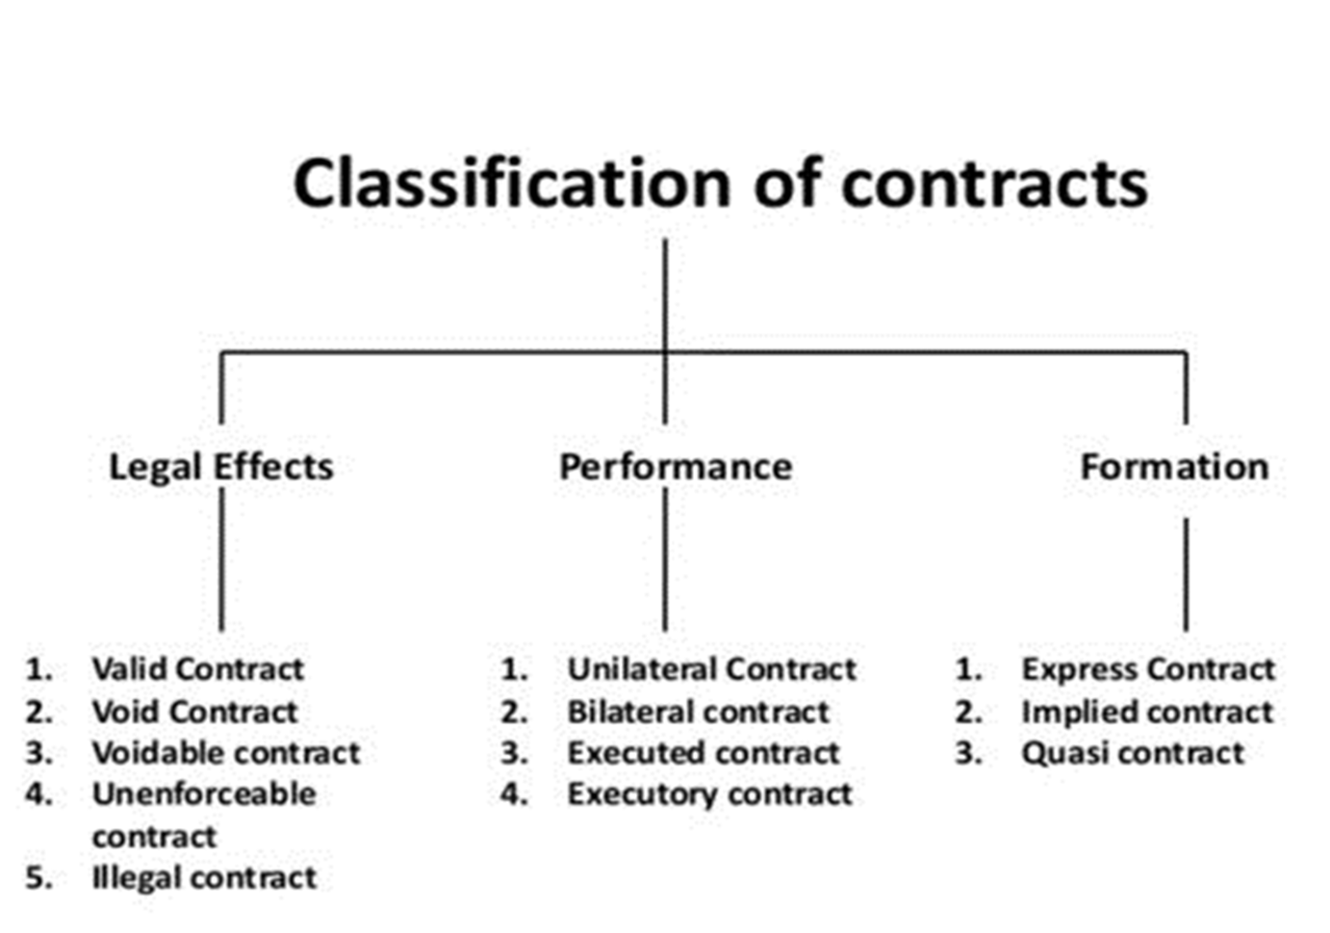

Slide 19
LEGAL EFFECTS
1.Valid Contracts:- enforceable by law
2.Void Contract :-which ceases to be enforceable by law, not binding in law.
Example: A agrees to pay B a sum of Rs 10,000 after 5 years against a loan of Rs. 8,000. A dies of natural causes in 4 years. The contract is no longer valid and becomes void due to the non-enforceability of the agreed terms.
3. Voidable contract:- enforceable by law at option of one of the parties (A, threatens to shoot B if he does not sell his new Bajaj bike to A for Rs. 2000, B agrees. The contract has been brought about by coercion and is voidable at the option of B).

Slide 20
4.Unenforceable Contracts:- Unenforceable contracts are rendered unenforceable by law due to some technical. The contract can’t be enforced against any of the two parties.
For example, A agrees to sell to B 100kgs of rice for 10,000/-. But there was a huge flood in the states and all the rice crops were destroyed. Now, this contract is unenforceable and can not be enforced against either party.
5. Illegal Contract:- An agreement that leads to one or all the parties breaking a law or not conforming to the norms of the society is deemed to be illegal by the court. A contract opposed to public policy is also illegal.
For example, A agrees to sell narcotics to B. Although this contract has all the essential elements of a valid contract, it is still illegal.

Slide 21
PERFORMANCE
1. Bilateral contract:- Both the parties commit to perform their respective promises
Example : A offers to sell his fiat car to B for Rs.1,00,000 on acceptance of A’s offer by B, there is a promise by A to Sell the car and there is a promise by B to purchase the car there are two promise.
2.Unilateral contract:- A unilateral contract is a one sided contract in which only one party has to perform his promise or obligation party has to perform his promise or obligation to do or forbear.
Example :- A wants to get his room painted. He offers Rs.500 to B for this purpose B says to A “ if I have spare time on next Sunday I will paint your room”. There is a promise by A to pay Rs 500 to B. If B is able to spare time to paint A’s room. However there is no promise by B to Paint the house. There is only one promise.

Slide 22
3. Executed contract :- A contract in which both the parties have fulfilled their obligations under the contract.
Example: A contracts to buy a car from B by paying cash, B instantly delivers his car.
4. Executory contract:- A contract in which both the parties have still to fulfilled their obligations.
Example : D agrees to buy V’s cycle by promising to pay cash on 15th July. V agrees to deliver the cycle on 20th July.

Slide 23
FORMATION
Express Contract – by words -spoken or written.
The contracts are made by the use of words or are written. Forming of conditions is done by either of these methods while making a contract.
A offers B to sell his house for 70,000 and B agrees to buy and make a written contract then it will be a type of express contract
2. implied Contract – Contracts made by the use of gestures or actions are known as implied contracts. A contract need not be formal or expressed all the time.
3. Quasi Contract –no person should enjoy benefit at the cost of others.

Slide 24
consideration
Definition
Section 2(d) of Indian Contract Act ; ‘when at the desire of the promisor, the promisee or any other person has done or abstained from doing ,or does or abstains from doing ,or promises to do or to abstain from doing something ,such act or abstinence or promise is called a consideration for the promise.’ example: A agrees to sell his home to B for Rs10,00,000.here B’s promise to pay Rs1000000 is the consideration for A’s promise to sell the home and A’s to sell the home is the consideration for B’s promise to pay rs1000000

Slide 25
Four components from definition
The act or abstinence or promise which forms the consideration for the promise, must be done at the desire of the promisor
It must be done by the promisee or any other person
It may have been already executed or is in the process of being done or may be still executory
It must be something to which the law attaches a value

Slide 26
Essentials of a valid consideration
It must move at the desire of the promisor
It may move from the Promisee or Any Other Person.
Consideration May Be Past, Present or Future
It Must Be Real, Certain and Lawful.
Consideration May Be Positive or Negative.
It Need Not Be Adequate.

Slide 27
Legality of objects
In order to constitute a valid contract, both consideration as well as object must be lawful; otherwise would be void.
According to section 23,’ the consideration or object of an agreement is lawful unless it is forbidden by law; or is of such a nature that if permitted, it would defeat the provisions of any law, or is fraudulent; or involves or implies injury to the person or property of another; or the court regards it as immoral, or opposed to public.in each case of these cases , The consideration or object of an agreement is unlawful is void.

Slide 28
Forbidden by law –this clause refers to agreements which are declared illegal by law. If the consideration or objet for a promise is such as is forbidden by law, the agreement is void.an act or an undertaking is forbidden by law :
1. when it is punishable by the criminal law of the country
2. when it is prohibited by special legislation or regulation made by a competent authority under power derived from the legislature.
Eg. An agreement to pay consideration to tenant to induce him to vacate premise governed by the rent restriction act illegal and cannot be enforced because such an act is forbidden by the said act (Mohanchana VS Manindra)

Slide 29
If it is of such a nature that, if permitted, it would defeat the provisions of any law. This clause refers to cases that ,though not directly forbidden by law, it would indirectly lend to a violation of law, whether enacted or otherwise.eg. Hindu and Muhammadan laws.
If it is fraudulent- an agreement whose object or consideration is to defraud others, is unlawful and hence void.
If it involves or implies injury to the person or property of another- if the object or consideration of an agreement is injury to the person or property of another, it is void, being an unlawful agreement.
If the court regards it as immoral- an agreement whose object or consideration is immoral ,is illegal and therefore void.
If the court regards it as opposed to public policy-an agreement is unlawful if the court regards it as opposed to public policy .

Slide 30
Consent
section 13 of Indian Contract Act defines the term consent and lays down that two or more persons are said to consent when they agree upon the same thing in the same sense.It involves identity of mind or consensus ad idem.
Free consent –defined as, section 14 lays down that, consent is said to be free, when it is not caused by –
a. Coercion
b. Undue influence
c. Misrepresentation
d. Fraud
e. Mistake

Slide 31
Revocation of offer
It implies taking back or withdrawing or cancelling an offer.
Section 5 states , ‘a proposal may be revoked at any time before the communication of its acceptance is complete as against the proposer, but not afterwards

Slide 32
According to section 6, an offer stand lapsed when in any of the circumstances:
1.communicationof notice of revocation
2.Lapse of time
3.Failure to fulfil a condition precedent to acceptance
4. Death or insanity of either party
5.Refusal or counter- offer
6.Acceptance differs from the prescribed one
7.Subsequent illegally or distraction of subject matter

Slide 33
Acceptance
Manifestation of assent to the term of offer.
Section 2(b) defines acceptance as ,when the person to whom the proposal is made signifies his assent thereto the proposal is said to be accepted.
It may be in the form of oral or written.
Legal rule governing an acceptance
It should be made by the offeree
It should be unconditional
It should be communicated to the offeror
It may be in any form, written or oral
It should be in the mode prescribed by the offeror
It should be given within a reasonable time
It should be given while the offer in force.

Slide 34
Communication of revocation of offer or acceptance
It is complete for the person revoking it when the letter of revocation is posted, and for the person to whom it is made when the letter of revocation reaches him.
Competence
‘Every person is competent to contract who is the age of majority according to the law to which he is subject ,and who is of sound mind, and is not disqualified from contracting by any law to which he is subject’- section 11
incompetent person
1.If he is a minor, according to the law to which he is subject
2.If he is unsound mind
3.If he is disqualified from contracting by any law to which he is subject .

